Slide 1
Developing a dialectical perspective to cultural – historical theory
Manolis Dafermos
University of Crete

Slide 3
The disappearance of dialectics
Dialectics has disappeared from sight in North Atlantic Academy.
Increasing individualisation and fragmentation of social life
the lack of dialectical mode of thinking
Popper (1940) argued that dialectics should be refused, because it violates the laws of formal logic, especially the law of non-contradiction. Contradictions should be eliminated from science.
The devaluation of the dialectic underpinnings of cultural-historical theory
The tendency of the reception of CHT through the lens of the dominant ways of thinking in North Atlantic Academy.
Sokolova (2011) in the past few decades “dialectic” became in Russia a kind of dirty word.
the dialectical underpinnings of Vygotsky’s theory have been forgotten.
the real social contradictions are rapidly growing, while the dialectical way of reasoning is ignored and devaluated.

Slide 4
Dialectics Neither Eclectic nor Dogmatic
Dogmatic:“My answer is right and all others are wrong”
Eclecticism:“Each meaning gives a partial view so the more meanings the better”
1. A dogmatic reception of Vygotsky’s theory and the canonization of Vygotsky’s as a thinker. Being just “epigone”, an imitator, deprived of an independent, original thinking constitutes a real dangerous for contemporary followers of Vygotsky or others prominent personalities.
2. An eclectic reception of certain ideas of Vygotsky’s theory and their incorporation into other conceptual schemes. The eclectic combination some ideas of CHT with other theoretical systems became an attractive strategy in times of post-modern celebration of the fragmentation and inconsistency. Post-modern celebration of the fragmentation tends to lead to creating a Frankenstein monster.

Slide 5
What is dialectic?
Various forms of dialectic historically emerged as ways to face puzzlement, aporia, antinomies, paradoxes, contradictions, etc.
Focusing on a process rather than a result or a set of predetermined postulates.
Two forms of dialectic in the history of human thinking: spontaneous (naïve) dialectic and Conscious (or systematic) dialectic.

Slide 6
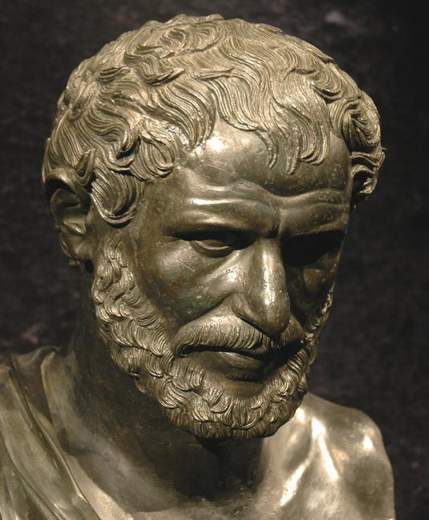
Spontaneous (naïve) dialectics
An attempt to offer a living, sensory concrete perception of the world in the process of its change and becoming.
The lack of developed conceptual thinking, the use of sensory (perceptual) equivalents to illustrate the movement of the world.
Ancient Greek dialectics, Chinese dialectic, Indian negative dialectic are forms of spontaneous dialectic.
“We step and do not step into the same rivers, we are and are not” (Heraclitus)
“I-Ching” (“The Book of Changes”) subtle observation and understanding of the contraries and changes in the universe and the human world

Slide 7
Conscious (or systematic) dialectics
It emerged in conflict with the metaphysical mode of thinking based on the consideration of reality as a sum of separated, unconnected, independent entities. The metaphysical outlook considers things as isolated and abstracted from their context, unchanging and immutable.
Kant’s “Critique of Pure Reason” dialectic as a “logic of illusions” (Kant, 1998, p.384). Thinking confronts with antinomies and falls into conflict with itself when it goes beyond sensory experience.

Slide 8
Hegel’s concept of dialectic
Understanding (Verstand) abstract thinking
the process of differentiation of a specific thing as a distinct, separated from its interrelation with other things and an analysis of its elements. Understanding offers an abstract way of thinking based on an analysis of fixed definitions (abstract universality).
Reason (Vernunft) is the process of the integration and creation of a concrete universal. It provides a synthetic account of the thing as a whole. A doctrine of reason in the process of elucidating and resolving contradictions and a systematic treatment of a concrete unity of opposed determinations.

Slide 9
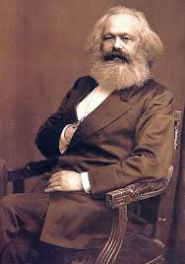
Materialist dialectics
a systematic investigation of political economy of capitalism (“Capital” K.Marx). Materialistic dialectics is oriented to a theoretical reconstruction of a living, organic, developing whole through creation of a system of interrelated categories.

Slide 10
Toward a dialectical approach to cultural historical theory
1. the dialectics of history - the historical context of the formation of cultural historical theory in Soviet Union in 1920s early 1930s.
2. the dialectics of development of science- the crisis of psychology as a discipline in early 20th century.
3. the dialectics of Vygotsky’s creative development as a personality - building of new theory in the domain of psychology.

Slide 11
Key methodological issues of dialectics
1. the relations between essence and phenomenon (surface).
2. The ascent from the abstract to the concrete and its relation to the movement of thinking from the sensory- concrete to the abstract.
3. The relations between the logical and historical method.

Slide 12
1. the relations between essence and phenomenon (surface).
Calling into question the cult of empiricism . the celebration of “the world of the pseudoconcrete”, “the world of external phenomena which are played out on the surface of real essential processes” (Kozik, 1976, p.2).
The investigation of internal, essential relations of a developing object challenges empiricism based on the Locke’s idea that knowledge derived from sensuous experience.
The ‘postulate of immediacy’ was challenged not only by Vygotsky but by other Soviet psychologists (Leontiev, Uznadtze, etc.)

Slide 13
2. Exploring the ascent form the abstract to the concrete
Vygotsky tended to associate the concrete thought with factually based mental "complexes" and abstract thought to logical "concepts".
“The most important characteristic of complexive thinking is that it occurs on the plane of concrete-empirical thinking rather than on the plane of abstract-logical thinking. Therefore, the complex is not characterized by the underlying unity of connections which helped to establish it”. (Vygotsky 1987a, p.137)
"Consciousness [...] begins to assume a concrete character. Words, through which the world is reflected, evoke a system of practically actuated connections. It is only at the final stage that consciousness acquires an abstract verbal-logical character, which differs from the earlier stages both in its meaning structure and in psychological processes, although even at this stage the connections that characterize the previous stages are covertly preserved." (Luria
1982, p.53).

Slide 14
2. Exploring the ascent form the abstract to the concrete
Vygotsky and Luria tended to associate thinking with the abstract thinking and generalization function with the category of “abstractness” (Braun 1991). In other words, thinking was investigated by Vygotsky mainly in terms of understanding rather than in terms of reason. The view of thinking as an abstract, logical process.
The abstract thought as the final stage of concept development. “Concepts are distributed between poles ranging from an immediate, sensual, graphic grasping of the object to the ultimate generalization (i.e., the most abstract concept)” (Vygotsky, p.226). The term “concrete” is defined as an immediate sensory grasp of an object, while the “abstract” as its maximally generalized conceptualization.
Ilyenkov criticized the identification of the concrete with the sensual experience and the abstract with a mental schema or sign description of the concrete (empiricist philosophy of the 16th and 17th centuries).

Slide 15
3. Vygotsky’s reproduced Engels's interpretation of the interrelation between the logical and historical methods
“Dialectical thinking does not place logical and historical methods for acquiring knowledge in opposition to one another. In accordance with Engels's well known definition, the logical method of investigation is itself an historical method. Logical methods are merely freed from their historical form and from the element of chance in history that interferes with the structure of the scientific account. The logical course of thought and history begin with the same thing. Moreover, the development of logical thought is nothing but a reflection of the historical process in an abstracted and theoretically consistent form. It is a refined reflection of the historical process, but it is refined in correspondence with the laws that historical reality itself teaches us. The logical mode of investigation provides the possibility for studying any aspect of development in it most mature stage and in its classic form” (Vygotsky 1987a, p.146-147).

Slide 16
3. Marx’s understanding of the problem of the relation between the logical and historical
Marx (1957) in his “Introduction” to “A Contribution to the Critique of Political Economy” proposed a different perspective to.
“It would be inexpedient and wrong therefore to present the economic categories successively in the order in which they have played the dominant role in history. On the contrary, their order of succession is determined by their mutual relation in modern bourgeois society and this is quite the reverse of what appears to be natural to them or in accordance with the sequence of historical development. The point at issue is not the role that various economic relations have played in the succession of various social formations appearing in the course of history; even less is it their sequence “as concepts” (Proudhon) (a nebulous notion of the historical process), but their position within modern bourgeois society” (Marx 1957)
The economic categories should be presented in their mutual relation in modern bourgeois society rather than in the order in which they have played the dominant role in history.

Slide 17
Developmental helix
1.The genetic method constitutes the movement of the product of the development to its initial stages. In others words, the genetic method depicts a movement from the present state to the past.
2. The concept of ZPD reflects the movement from the actual form of development toward its future forms.
“The transition of the basic epistemology of science from explaining what has happened (Past to Present) to what could, should, and might happen (Present to Future focus)... ” (Valsiner, Glăveanu and Gillespie, 2015, p. xviii ).
The past in its relation to present
The present (actual forms of development)
The future in its relation to present

Slide 18
Conclusion
“We are talking here not about the problem of the application of dialectics to the development of other fields of knowledge, whether it is political economy or physics, psychology or mathematics, economic policy or the field of burning political issues, but about the elaboration of the apparatus of dialectics itself, i.e, a system of its special concepts, categories” (Ilyenkov, 1991, p.57).
The crucial question of the further development of the conceptual apparatus of dialectics itself posed by Ilyenkov, Vaziulin and other thinkers remains unsolved.

