Slide 1
Perezhivanie: tantalizing concept?
Dialogue with Vygotsky
Nikolai Veresov,
Monash University, Australia

Slide 2
. . . perezhivanie thus far remains more a tantalizing notion than a concept with clear meaning and import to those who hope to draw on it.
(Smagorinsky 2011, p. 339).

Slide 3
Antoniadou, V. (2011). Virtual collaboration, ‘perezhivanie’ and teacher learning: a socio-cultural-historical perspective. Bellaterra Journal of teaching & learning language & literature, 4(3), 53-70
Brennan, M (2014). Perezhivanie: What Have We Missed about Infant Care? Contemporary Issues in Early Childhood, 15, 284-292.
Chen, F. (2015). Parents' perezhivanie supports children's development of emotion regulation: a holistic view. Early child development and care, 185, (6), 851-867
Daniels, H. (2008). Vygotsky and research. Routledge.
Daniels, H. (2010). Motives, emotion, and change. Cultural-historical psychology, 2, 24-33.
Fakhrutdinova L. (2010). On the Phenomenon of “Perezhivanie”. Journal of Russian and East European Psychology, 48 (2), 31-47.
Ferholt, B. (2009). The development of cognition, emotion, imagination and creativity as made visible through adult-child joint play: perezhivanie through playworlds (Doctoral dissertation). University of California, San Diego.
Ferholt, B. (2010). A synthetic-analytic method for the study of perezhivanie: Vygotsky literary analysis applied to playworlds. In M. C. Connery, V. John-Steiner & Ana Marjanovic-Shane (Eds.), Vygotsky and creativity: a cultural-historical approach to play, meaning making, and the arts (pp. 163-179). Peter Lang.
Fleer, M. (2013). Theorising Play in the Early Years. Cambridge University Press
Quiñones, G. & Fleer, M. (2011). "Visual Vivencias": A cultural-historical tool for understanding the lived experiences of young children's everyday lives". In E. Johansson & J. White (Eds.), Educational research with our youngest: Voices of infants and toddlers. Netherlands: Springer.
Mahn, H. (2003). Periods in child development. Vygotsky’s perspective. In A. Kozulin, B. Gindis, V. Ageyev & S. Miller (Eds.),Vygotsky's educational theory in cultural context (pp.119-138). Cambridge.
Mahn H, John-Steiner, V. (2002). The gift of confidence: A Vygotskian view of emotions. In G. Wells & G. Claxton (Eds.). Learning for Life in the 21st Century: Sociocultural Perspectives on the Future of Education (pp. 46 – 58). Blackwell.

Slide 4
2014
- ISCAR Sydney Congress: 5 presentations and 3 symposia on perezhivanie
2015
ISCAR Australia-Brazil international symposium on perezhivanie (Melbourne, Monash University, February)
2016
International research in Early childhood journal (IRECE) – special issue on perezhivanie
Mind, Culture and Activity journal (MCA) – special issue on perezhivanie
2017
“Perezhivanie, emotions and subjectivity” – book, Springer Publishers

Slide 5
“Perezhivanie is
“probably one of the most used and least understood constructs to appear in contemporary literature”

Slide 6
Zone of proximal development is
“probably one of the most used and least understood constructs to appear in contemporary educational literature”
Palinscar, A. S. (1999). Keeping the metaphor of scaffolding fresh — A response to C. Addison Stone’s “The metaphor of scaffolding: Its utility for the field of learning disabilities”. Journal of Learning Disabilities, 31, p.370

Slide 7
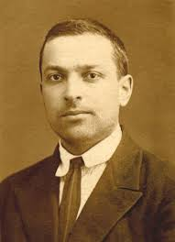
ARE WE STILL INTERESTED IN WHAT VYGOTSKY
MEANS BY PEREZHIVANIE?
What are methodological challenges?
What are consequences to inform our research?

Slide 8
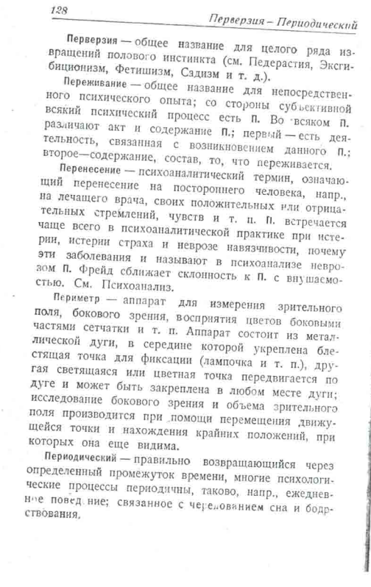
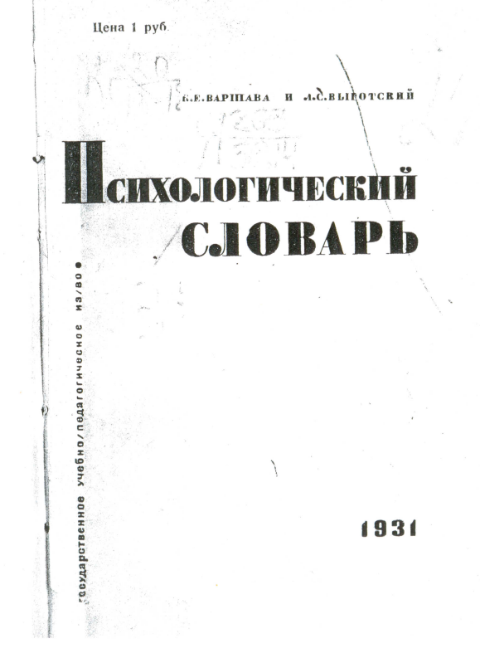

Slide 9
Perezhivanie (переживание) is a common name for direct psychological experience*. From a subjective perspective, every psychological process is perezhivanie. In every perezhivanie we distinguish: firstly, an act, and secondly, the content of perezhivanie. The first is an activity related to the appearance of certain perezhivanie; the second is the content, the composition of what is experienced (Varshava & Vygotsky 1931, p. 128).
*Opyt (опыт) in the Russian original text.

Slide 10
What is perezhivanie?
Psychological phenomenon (P.1)
P1.1. an activity connected to the emergence of the given perezhivanie (HOW? Process)
P1.2. the content constituting what is being experienced
(WHAT? Content)
EXAMPLE: THINKING (PROCESS) – THOUGHT (CONTENT)

Slide 11
PEREZHIVANIE AS A CONCEPT IN CULTURAL-HISTORICAL THEORY - P2.
…perezhivanie is a concept which allows us to study the role and influence of environment on the psychological development of children in the analysis of the laws of development.
Vygotsky, 1994, p.343

Slide 12
Perezhivanie
My dialogue with Vygotsky is about this
Phenomenon
(P1)
Concept
(P2)

Slide 13
WHAT IS THE THEORETICAL CONTENT OF THE CONCEPT OF PEREZHIVANIE (P2)?
TO FIND AN ANSWER WE HAVE TO IDENTIFY:
What aspect of human development this concept is related to?
How is this concept connected with other concepts within the theory?

Slide 14
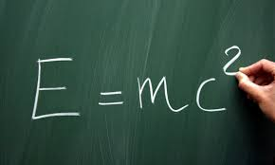

Slide 15
Perezhivanie in Vygotsky’s texts:
the prism
the unit of individual and environmental characteristics

Slide 16
Perezhivanie as a prism that refracts social influences
…it is not any of the factors in themselves (if taken without reference to the child) which determines how they will influence the future course of his development, but the same factors refracted through the prism of the child's perezhivanie (Vygotsky, 1994, p.339-340).
REFLECTION --------- REFRACTION

Slide 21
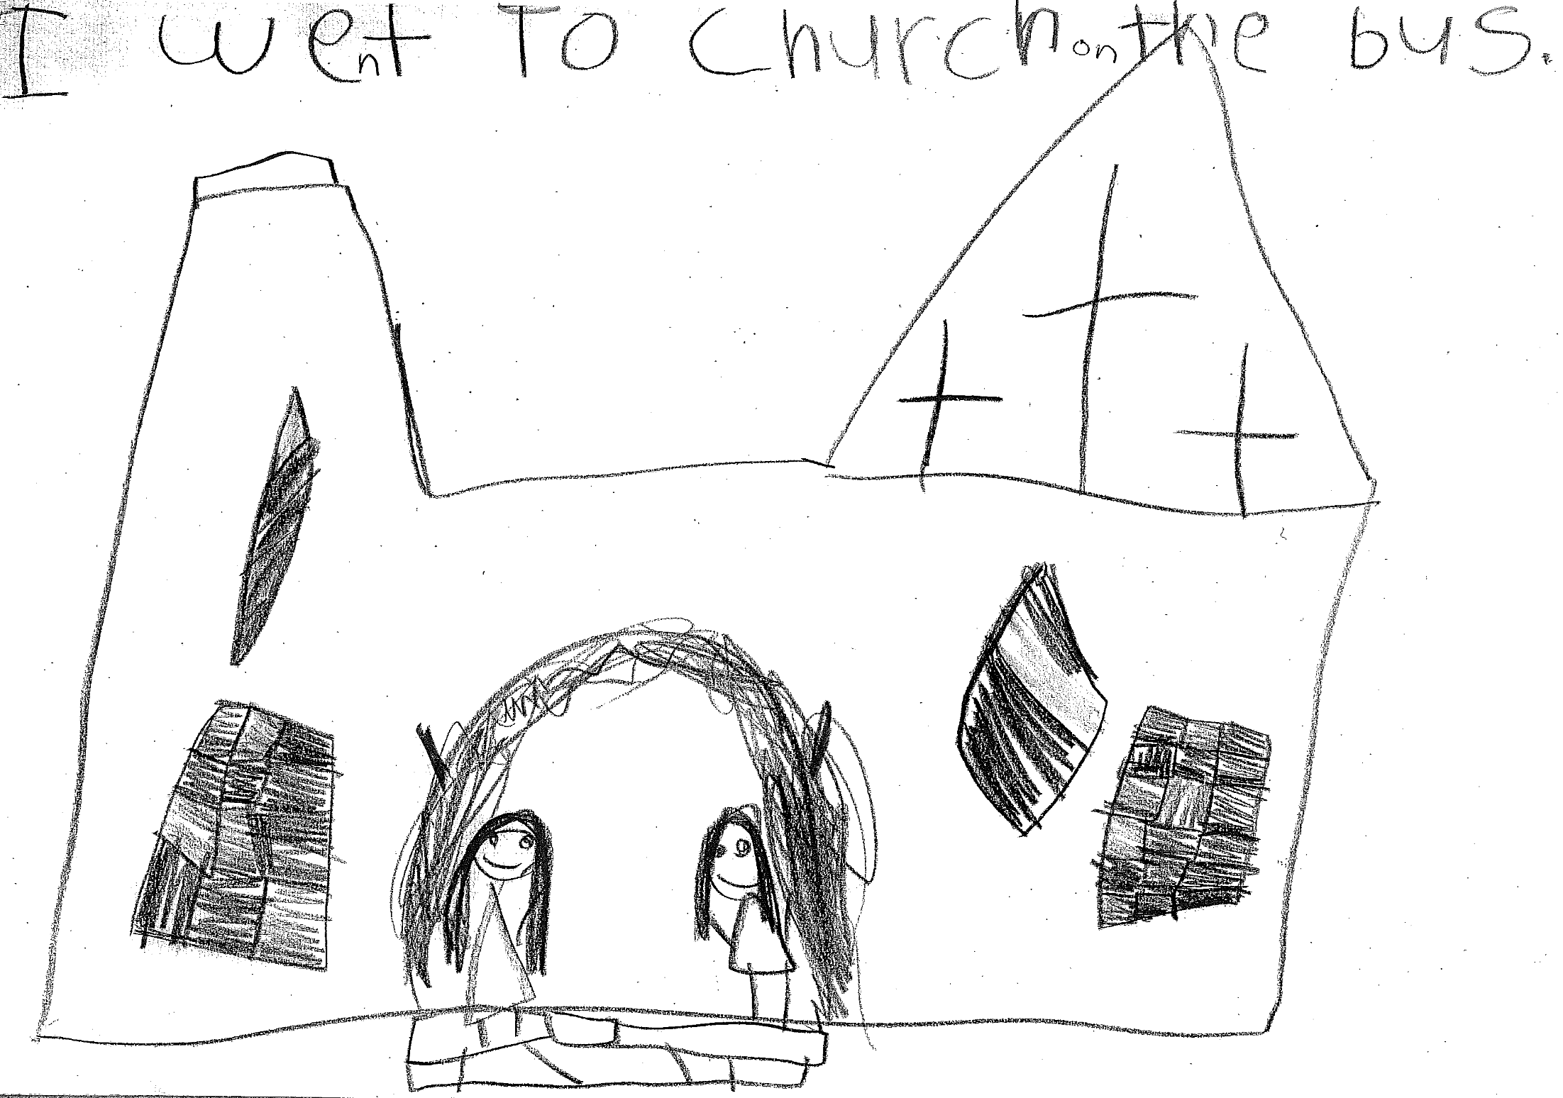

Slide 22
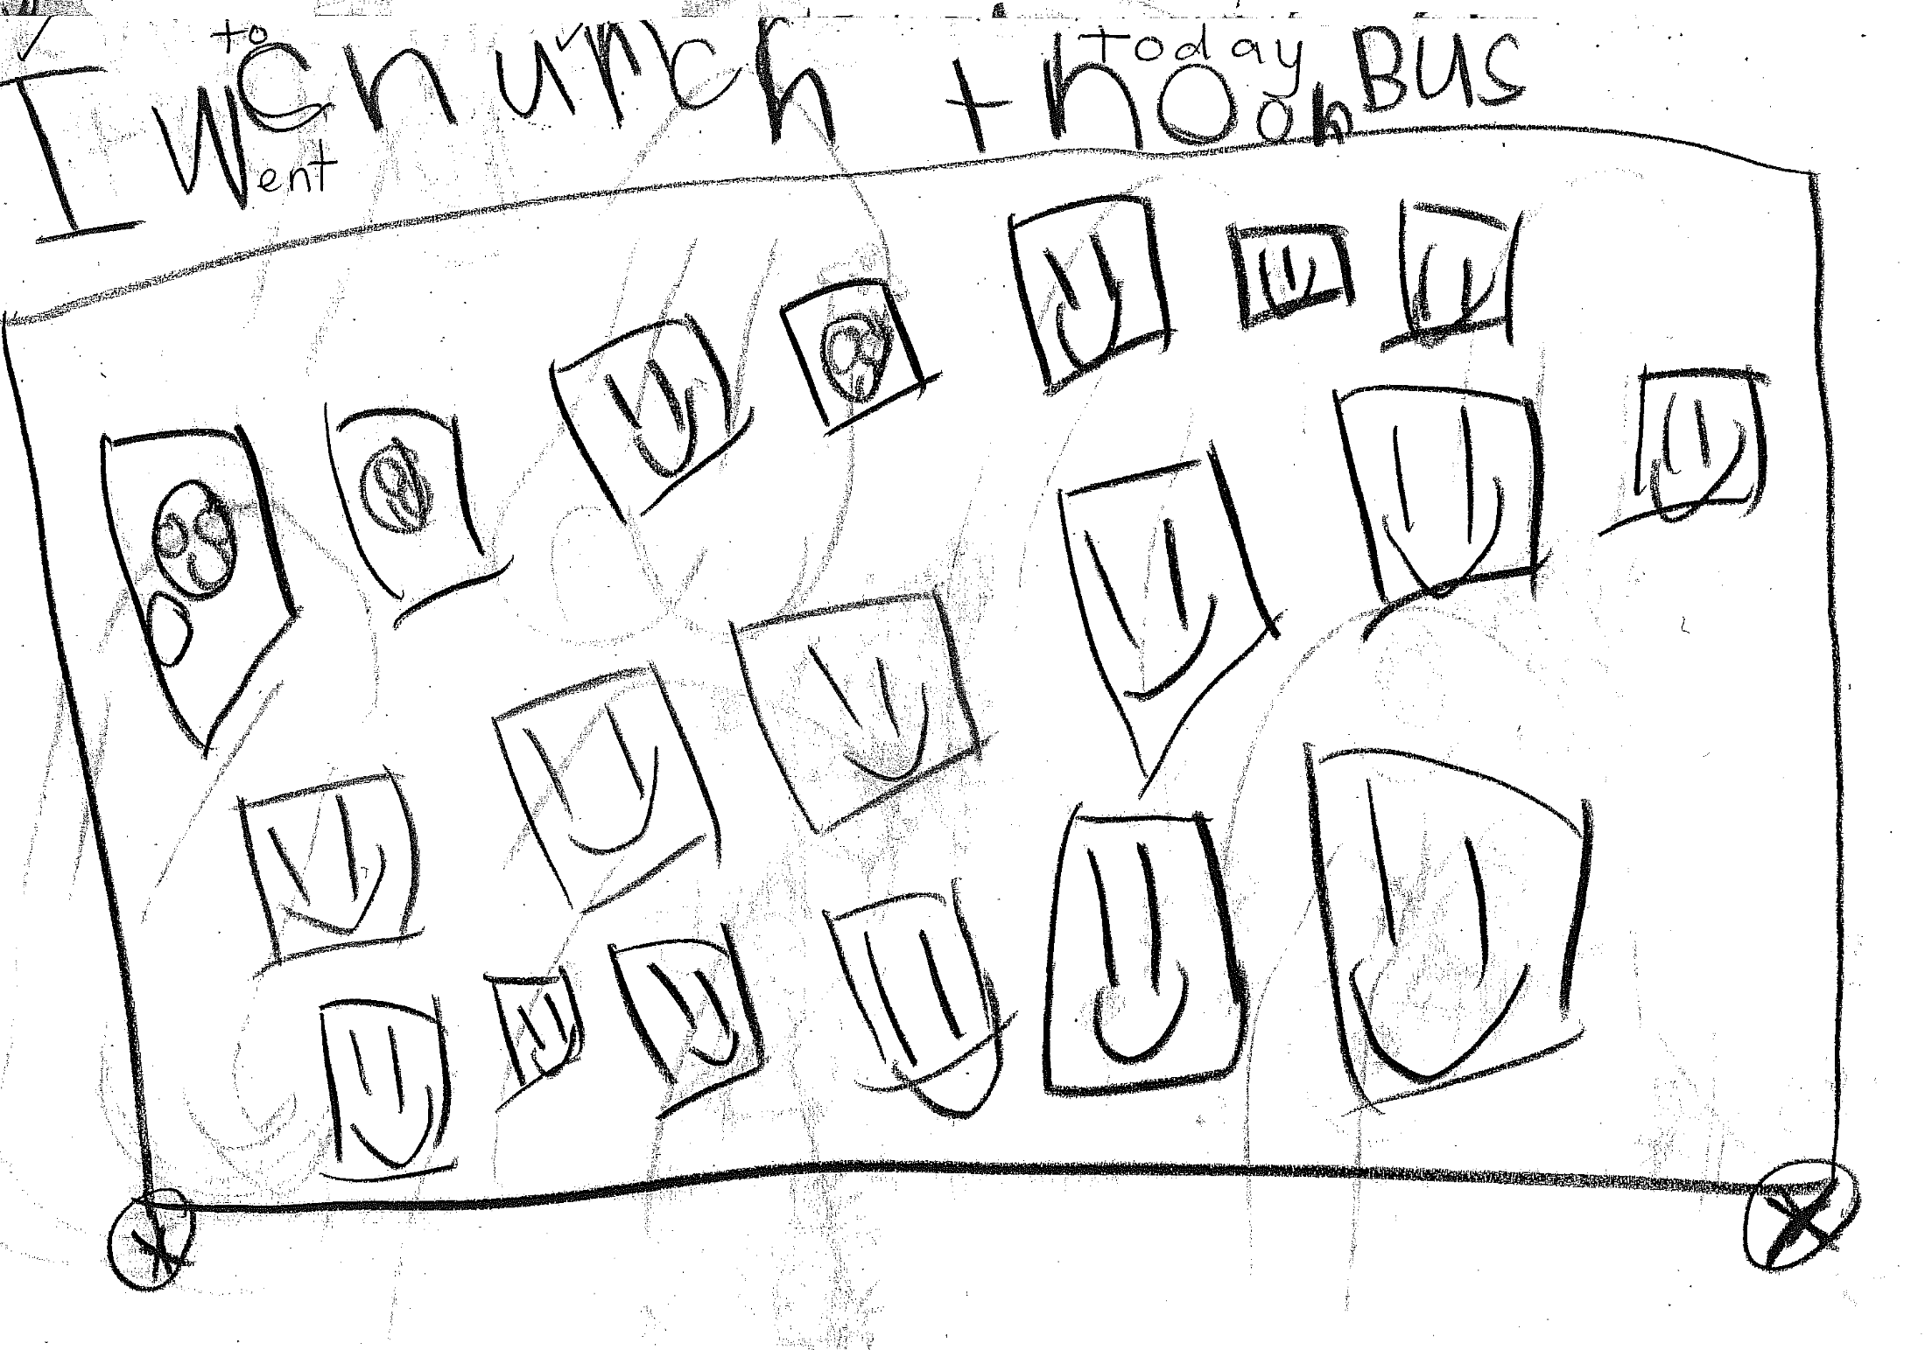

Slide 23
Which of presented is about P2?

Slide 24
…it is not any of the factors in themselves (if taken without reference to the child) which determines how they will influence the future course of his development, but the same factors refracted through the prism of the child's perezhivanie (Vygotsky, 1994, p.339-340).
This is such a prism which determines the role and influence of the environment on the development on...the child's character, his psychological development, etc. (Vygotsky, 1994, p. 341)
HOWEVER, WHAT DOES IT ACTUALLY MEAN?

Slide 25
1. Social environment as a source of development
The social environment is the source for the appearance of all specific human properties of the personality gradually acquired by the child or the source of social development of the child (Vygotsky. 1998, p. 203).
Development - how the social becomes the individual

Slide 26
SOCIAL SITUATION OF DEVELOPMENT:
…completely original, exclusive single and unique relation specific to the given age, between the child and reality, mainly the social reality, that surrounds him. We call this relation the social situation of development at given age. The social situation of development represents the initial moment for all dynamic changes that occur in development... It determines wholly and completely the forms and the path along which the child will acquire ever newer personality characteristics, drawing them from the social reality as from the basic source of development, the path along which the social becomes the individual (Vygotsky, 1998, p.198).

Slide 27
We are dealing with three children, brought to us from one family. The external situation in this family is the same for all three children... The mother drinks and, as a result, apparently suffers from several nervous and psychological disorders. The children find themselves in a very difficult situation. When drunk, and during these breakdowns, the mother had once attempted to throw one of the children out of the window and she regularly beat them or threw them to the floor. In a word, the children are living in conditions of dread and fear due to these circumstances (Vygotsky, 1994, p.339-340).
The three children are brought to our clinic, but each one of them presents a completely different picture of disrupted development, caused by the same situation. The same circumstances result in an entirely different picture for the three children (Ibid).

Slide 28
The youngest of these children…
...reacts to the situation by developing a number of neurotic symptoms, i.e. symptoms of a defensive nature. He is simply overwhelmed by the horror of what is happening to him. As a result, he develops attacks of terror, enuresis and he develops a stammer, sometimes being unable to speak at all as he loses his voice. In other words, the child's reaction amounts to a state of complete depression and helplessness in the face of this situation. (Ibid)

Slide 29
The second child approached the situation differently. He was
...developing an extremely agonizing condition, a state of inner conflict... On the one hand, from the child's point of view, the mother is an object of painful intensive (NV) attachment, and on the other, she represents a source of all kinds of terrors and terrible emotional experiences [perezhivanija] terrible impressions for the child (NV). The second child was brought to us with this kind of deeply pronounced conflict and a sharply colliding internal contradiction expressed in a simultaneously positive and negative attitude towards the mother, a terrible attachment to her and an equally terrible hate for her a terrific attachment to her and an equally terrific hate for her (NV), combined with terribly contradictory behaviour. (Vygotsky, 1994, p. 340).

Slide 30
Finally, the third and eldest child
...showed signs of some precocious maturity, seriousness and solicitude. He already understood the situation. He understood that their mother was ill and he pitied her. He could see that the younger children found themselves in danger when their mother was in one of her states of frenzy. And he had a special role. He must calm his mother down, make certain that she is prevented from harming the little ones and comfort them. Quite simply, he has become the senior member of the family, the only one whose duty it was to look after everyone else. As a result of this, the entire course of his development underwent a striking change. This was not a lively child with normal, lively, simple interests, appropriate to his age and exhibiting a lively level of activity. It was a child whose course of normal development was severely disrupted, a different type of child (Vygotsky, 1994, p. 340-341).

Slide 31
So ... depending on the fact that the same situation had been experienced by the three children in three different ways three different perezhivanie of the same situation appeared in three children (NV), the influence which this situation exerted on their development also turns out to be different (Ibid).

Slide 32
...by citing this example, I only wished to clarify the idea that... paedology does not investigate the environment as such without regard to the child, but instead looks at the role and influence of the environment on the course of development. …This is such a prism which determines the role and influence of the environment on the development of...the child's character, his psychological development, etc. (Ibid.)

Slide 33
An example shows that while the three children had the same social situation, they simultaneously had different social situations of development.
To state a certain, general, formal position it would be correct to say that the environment determines the development of the child through experience perezhivanie (NV) of the environment;. ..the child is a part of the social situation, and the relation of the child to the environment and the environment to the child occurs through experience... perezhivanie (NV) of the child himself; the forces of the environment acquire a controlling significance because the child experiences them (Vygotsky, 1998, p. 294).

Slide 34
General genetic law of cultural development – fundamental!

Slide 35
"Every function in the child's cultural development appears twice: first, on the social level, and later, on the individual level; first, between people (interpsychological) and then inside the child (intrapsychological).
All the higher functions originate as actual relationships between individuals." (Vygotsky, 1978, p57).
“...every function in the cultural development of the child appears on the stage twice, in two planes, first, the social, then the psychological, first between people as an intermental category, then within the child as a intramental category...Genetically, social relations, real relations of people, stand behind all the higher mental functions and their relations…every higher mental function was external because it was social before it became an internal strictly mental function; it was formerly a social relation between two people (Vygotsky 1997, p. 106)

Slide 36
Every higher mental function appears not IN social relations, but AS a social relation.
Social is not a factor, but as a source of mental development.
Category = drama!
The process of psychological development is a process of how inter-psychological becomes intra-psychological;
internalization is viewed as intra-lisation (from inter- to intra-), as a process of becoming intra-psychological as a unique combination of higher mental functions (psychological systems) of an individual within social contexts.
“an individual” is a unique unity of higher mental functions in motion, in its dialectical becoming.

Slide 37
THE CONCEPT OF DRAMA
BACK TO THE DIALECTICS OF BECOMING
Speaking on development we have to have in mind that the view of development in cultural-historical psychology originates in German philosophical tradition. Two aspects are important in this respect:
development is not possible without dialectical contradictions: contradiction is a moving force of development;
development is a process of qualitative reorganization of a certain system. To put it in a simple way – there is no development without dialectical contradictions and there is no development without qualitative reorganization of the system.

Slide 38
The basic principle of the functioning of higher functions (personality) is social, entailing interaction of functions, in place of interaction between people. They can be most fully developed in the form of drama…
…the dynamic of the personality is drama” (Vygotsky, 1929/1989, p. 67).” (Vygotsky, 1929/1989, p.59-61; Original emphasis)

Slide 39
Social environment is not a factor, it is a source of mental development
Development = how the social becomes and individual
Not transition from intra to inter, but the process of becoming
Through reorganisation of a system of mental functions
Dialectics of becoming = contradiction! Drama!

Slide 40
Drama of life = collision, contradiction
DRAMATIC PEREZHIVANIE
Qualitative change of the system of HMF
Turning point of developmental trajectory

Slide 41
in the same social situation, three children had three different perezhivanie and therefore experienced three different dramas. This means that the initial intermental forms of their relations were essentially different in the same social situation. Consequently, because the initial intermental forms were different, the children’s social situations of development and their individual developmental trajectories became different.

Slide 42
Perezhivanie as a theortetical concept:
P2.1. – the prism
P 2.2.Perezhivanie as a unit
Social situation of development
General genetic law of cultural development
Development as drama

Slide 43
Complex whole (unity) = единство (edinstvo)
Analysis by elements (элемент)
Analysis by units
(единица)
Does not contain basic characteristics of a complex whole
Contains basic characteristics of a complex whole

Slide 44
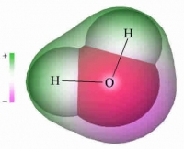
Unit
Complex whole (unity)

Slide 45
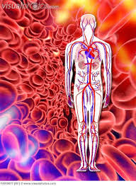
Unit
Complex whole (unity)

Slide 46
Vygotsky, 1998, Vol.5, p.294 | Vygotsky, 1984, Vol.4, p.382
A unity can be noted in the study of personality and environment. This unity … has been called experience. The child's experience is also this kind of very simple unity about which we must not say that in itself it represents the influence of the environment on the child or the individuality of the child himself; experience is the unity of the personality and the environment as it is represented in development. | A unit can be noted in the study of personality and environment. This unit …has been called perezhivanie. The child's perezhivanie is also this kind of very simple unit about which we must not say that in itself it represents the influence of the environment on the child or the individuality of the child himself; perezhivanie is the unit of the personality and the environment as it is represented in development.

Slide 47
Perezhivanie as a theortetical concept:
P2.1. – the prism
P 2.2.Perezhivanie as a unit of the unity of the environmental and personal aspects
Social situation of development
General genetic law of cultural development
Development as drama
SOCIAL SITUATION OF DEVELOPMENT

Slide 48
[Psychology] … ought to always be capable of finding the particular prism through which the influence of the environment on the child is refracted, i.e. it ought to be able to find the relationship which exists between the child and its environment, the child's...perezhivanie, in other words how a child becomes aware of, interprets, and emotionally relates to a certain event.

Slide 49
What is perezhivanie?

Slide 50
Translation | Original
In modern theory, experience is introduced as a unity of consciousness, that is, a unity in which the basic properties of consciousness are given as such, while in attention and in thinking, the connection of consciousness is not given. …experience is the actual dynamics of the unity of consciousness, that is, the whole which comprises consciousness Vygotsky, 1998, p. 294 | In modern theory, perezhivanie is introduced as a unit of consciousness, that is, a unit in which the basic properties of consciousness are given as such, while in attention and in thinking, the connection of consciousness is not given. Perezhivanie is a dynamic unit of consciousness, the consciousness consists of (складывается из) perezhivanie Vygotsky, 1984, p.382

Slide 51
Perezhivanie as a theortetical concept:
P2.1. – the prism
P 2.2.Perezhivanie as a unit of the unity of the environmental and personal
P2.3. - Perezhivanie as a unity dynamic unit of consciousness
Social situation of development
General genetic law of cultural development
Development as drama

Slide 52
Perezhivanie as a phenomenon (P1)
Phenomenological level of analysis
Process
Content
Conceptual level of analysis
Refracting prism
Unit of individual and environmental
Unit of consciousness

Slide 53
Academia.edu | https://monash.academia.edu/NikolaiVeresov
Google scholar | https://scholar.google.com.au/citations?user=Cr0Si9oAAAAJ&hl=en
Research gate | https://www.researchgate.net/profile/Nikolai_Veresov
Personal site | http://www.nikveresov.net/417072700
Monash research profile | http://monash.edu/research/explore/en/persons/nikolay-veresov(62b49fd9-59a7-43ae-8100-e2f001857866).html

